Slide 1

LEICedin
Group project for the Human Computer Interaction class
Faculty
Rui Rodrigues (lectures)
Teresa Galvão (recitations)
Students (G101)
Alexandre Nunes (202005358)
Gonçalo Pinto (202004907)
Guilherme Magalhães (202005285)

Slide 2
Description
LEICedin is an app to help students find employment and housing, in the first prototype we only implemented housing features.
Student
Student/User
Search for a room
Search for a job
Add room posting
Add job posting
Filter room search
Filter job search
Remove room posting

Slide 3
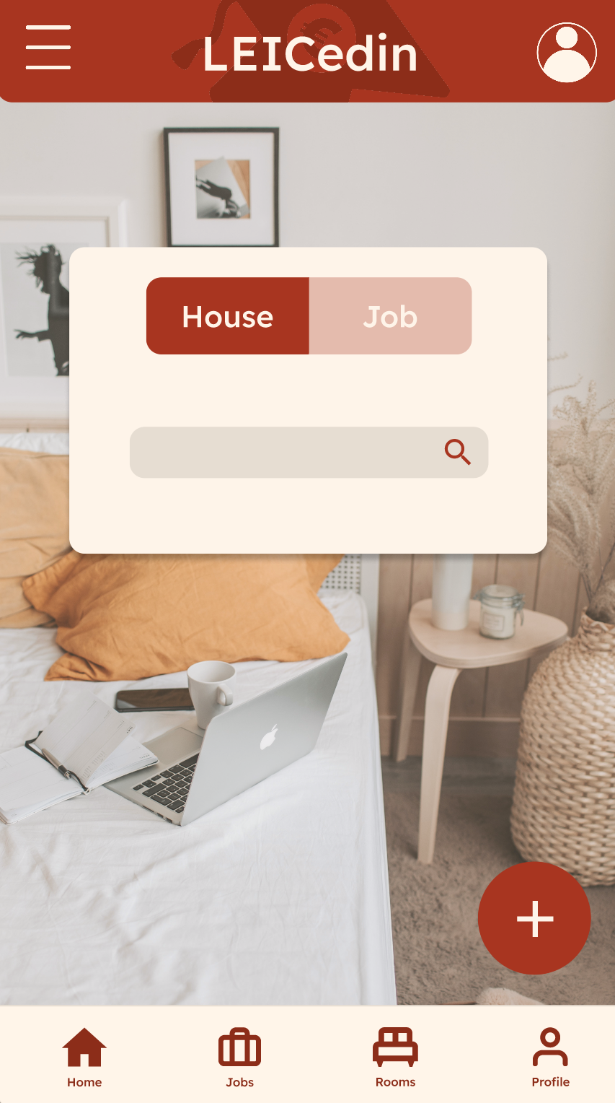
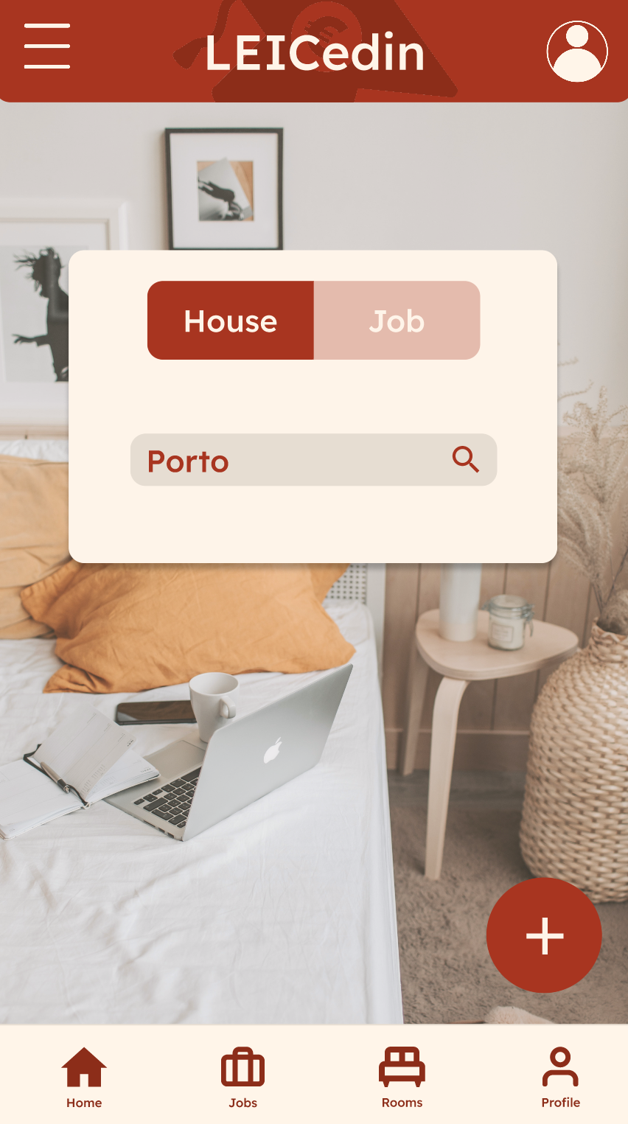
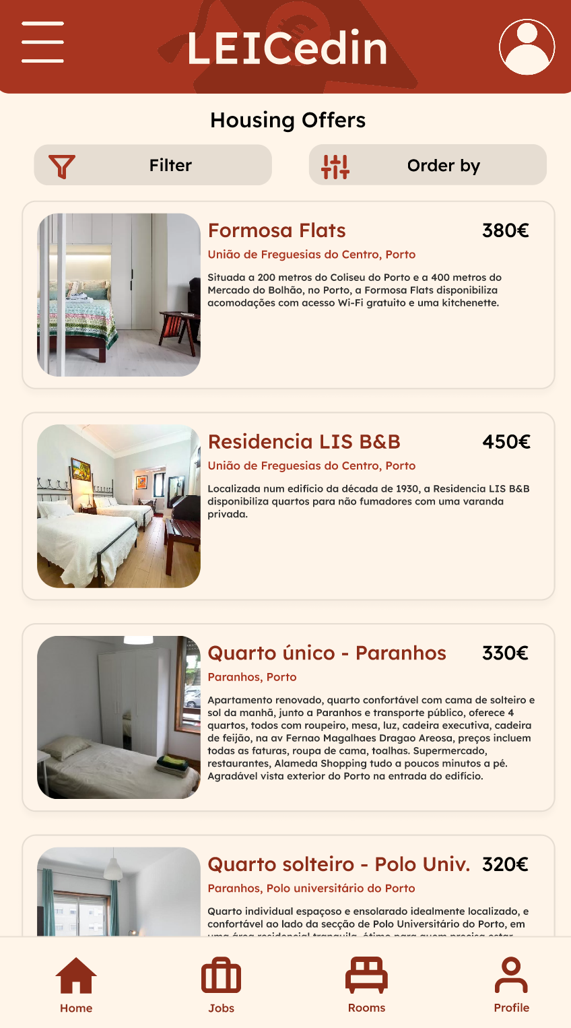
Search Feature Wireflow
SCR-01
SCR-02
SCR-03
Write keywords to search bar
Tap search button
Home Page
Home Page with info filled
Housing Page

